Slide 1
SAP CPI Groovy Scripts

Slide 2
Table of Contents
Groovy & Java Script
1
Key Groovy Functions & examples
2
Use Cases in CPI
3
4
Advanced Groovy scripting Techniques

Slide 3
1. Groovy & Java Script
What is Groovy ?
Groovy is an object-oriented dynamic programming language.
Groovy is a Java enhancer, it provides great flexibility and introduces special features to applications.
Groovy is simple, because it does not need all the elements that Java needs.
Groovy source code gets compiled in Java Bytecode, it can run on any platform if JRE is installed on that operating system.
In Groovy you don’t need to end statement with semicolon.
What is Javascript?
JavaScript is the Programming Language for the Web.
JavaScript can update and change both HTML and CSS.
JavaScript can calculate, manipulate and validate data.

Slide 4
1. Groovy & Java Script
Importance of Groovy in SAP CPI
Handling huge text files (which are csv or fixed length) is a challenge in CPI (SAP Cloud Platform Integration)
which is time and memory intensive.
All those cases can be done with required Groovy script quickly.
Groovy syntax is simple and easy.
It saves a lot of code and effort thus increasing the productivity of developer.
Groovy is dynamic language.
Seamless integration with all existing Java objects and libraries.
You can use it as much or as little as you like with Java apps.
Feels easy and natural to develop.
More concise and meaningful code compares to Java.

Slide 5
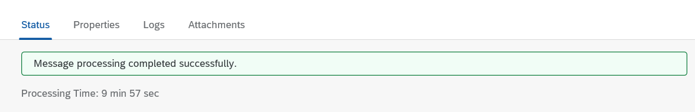
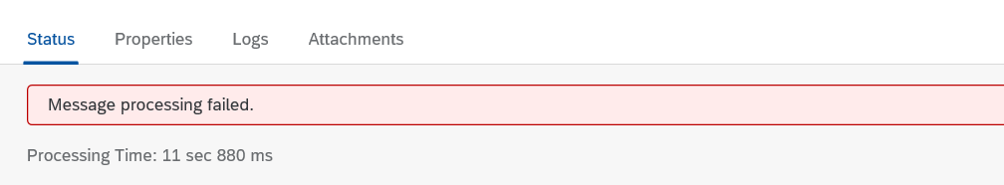
2. Groovy Functions & examples
Access System Parameters
Status –
In SAP Cloud Platform Integration we have Status parameter were we can see the message status, either failed or success.
In Status the Processing Time represents, time to process a message.

Slide 6
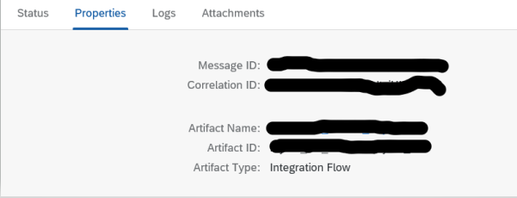
2. Groovy Functions & examples
Access System Parameters
B. Properties –
Message ID:- Message Id is assigned to a single message that is the unique and primary key to search the message. System will automatically assign the unique message Id to the messages.
Correlation ID:- Is like parent ID, suppose we need to send second message that depends on the first message.
Means second message will deliver only when first has already reached.
Artifact Name:-
Which is name of our Artifact.
Artifact ID :- Is Artifact Name.
Artifact Type :- Integration Flow

Slide 7
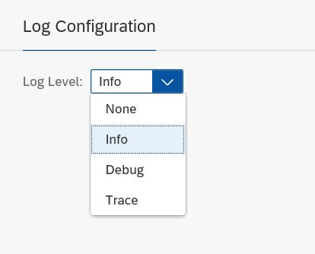
2. Groovy Functions & examples
Access System Parameters
C. Logs :-
Info-
The default log level is “Info”. All newly created integration flows will be logged with “Info” upon their initial deployment.
Debug-
Used for dumping variable state, specific error codes, etc.
Trace-
Can help pinpoint the location, in the code, of the error or other event logged at a different level.

Slide 8
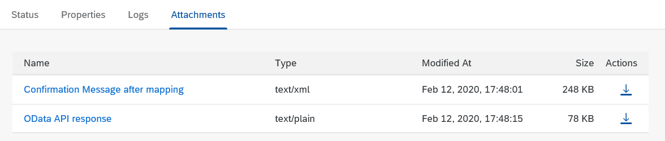
2. Groovy Functions & examples
D.Attachments:-
Name- Name of the attachments.
Type– Type of the Attachment, text or xml or plain.
Modified At- Is the date and time the message processed.
Size- Size of the file in KB.
Action– We can download the attachment.

Slide 9
2. Groovy Functions & examples
Access System Parameters
Set Property
In Groovy we can set values for properties with a simple assignment using the = operator. Groovy will invoke the set for us.
Get Property
To get the value of a property we can use dot (.) notation instead of the get method.

Slide 10
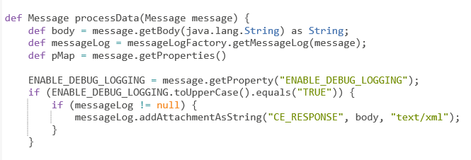
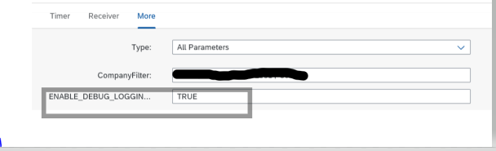
2. Groovy Functions & examples
Access System Parameters
Get Property in Groovy
Here “ENABLE_DEBUG_LOGGING”, is property and the value as “TRUE”
In below we have used the property in configuration

Slide 11
2. Groovy Functions & examples
References
https://groovy-lang.org/documentation.html
https://xebia.com/blog/why-and-when-to-use-groovy/

Slide 12
2. Groovy Functions & examples
Below are the few key groovy functions
Date Function :
Date and time functions are scalar functions that perform an operation on a date and time input value and returns either a string, numeric, or date and time value.
Follow the below mentioned blog and do practice your self in your system land scape.
Blog : Example 1
Date Function use case in CPI with Date Function_Groovy.docx

Slide 13
2. Groovy Functions & examples
Below are the few key groovy functions
Text Function :
A String literal is constructed in Groovy by enclosing the string text in quotations.Groovy offers a variety of ways to denote a String literal. Strings in Groovy can be enclosed in single quotes (’), double quotes (“), or triple quotes (“””). Further, a Groovy String enclosed by triple quotes may span multiple lines.
Follow the below mentioned blog and do practice your self in your system land scape.
Blog : Example 1
Text Function use case in CPI with Text Function_Groovy.docx

Slide 14
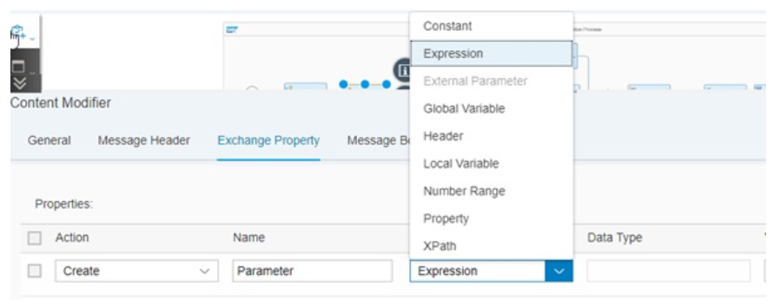
3. Use Cases in CPI
Get/ Set the properties of variables in groovy.
Logging payload.
Calling properties in Mappings.
Get/ Set the properties of variables in groovy:
We can create External parameters in Content modifier and we can Get/Set the parameters in groovy.
In Web GUI, now a days external parameter type is disabled.

Slide 15
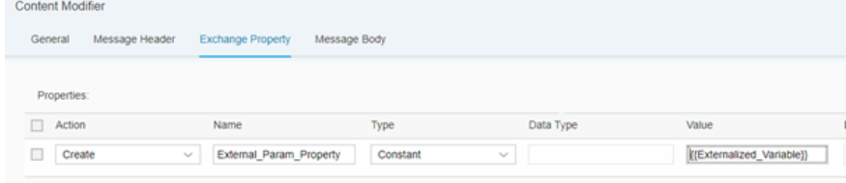
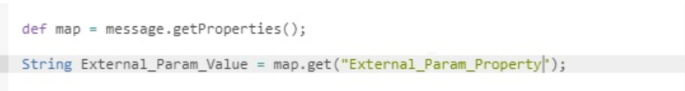
3. Use Cases in CPI
Instead of using an external parameter type, use either “Constant” or “Expression” type within content modifier. And in the value column, define the external parameter.
Once you have externalized, you can refer the same within the groovy script just as a normal property variable.
“map” is the variable we declaring, message.getProperties(); is used to get the properties of message to map variable.

Slide 16
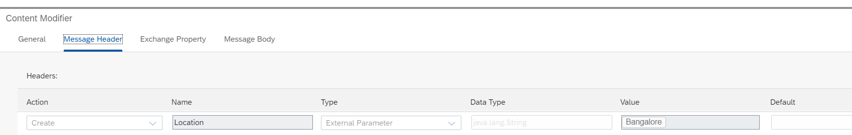
3. Use Cases in CPI
String External_Param_Value = map.get(“External_Param_Property”);
We creating “External_Param_Value” and getting the value from properties of Content modifier(External_Param_Property).
String External_Param_Value = map.setProperty(“External_Param_Property”,”True”);
setProperty()--is used to set the value of the property parameter declared in exchange property.
setHeader()-- is used to set the value of the header parameter declared in header of Content.M
Calling properties in Mappings:
We can declare the parameters in Content Modifier, we can call them directly in Message Mapping.
Ex: We created one variable in Content modifier called “Location” in header

Slide 17
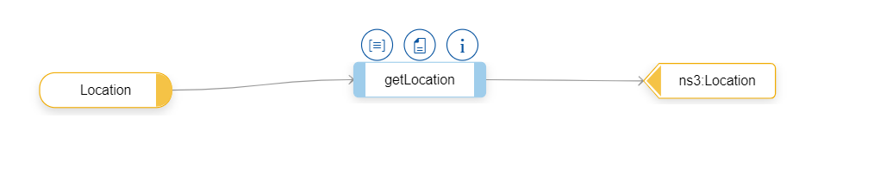
3. Use Cases in CPI
We are trying to access that from message mapping with groovy code as below.
getLocation- is the custom groovy function taking “location”(constant as input)
context.getHeader()---is used to get values from the header of content modifier in MM.
context.getProperty()---is used to get values from the exchange property of content modifier in MM.

Slide 18
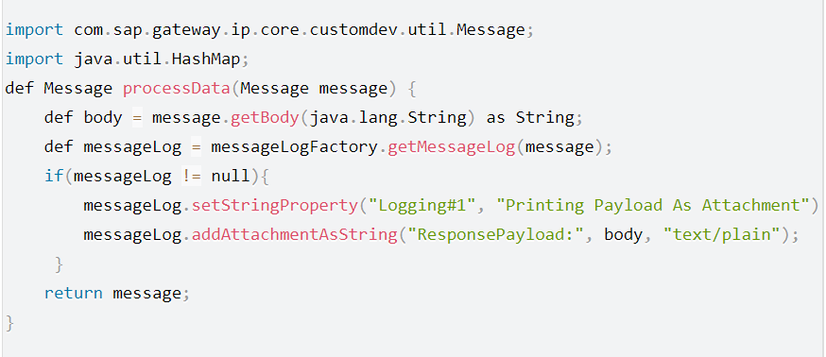
3. Use Cases in CPI
Logging payload:
In CPI, we can check the payload step to step in 2 ways.
1) Changing the log level to “TRACE” mode.
2)By logging the payload at each step. Standard script we are using this to get payload as
attachment.

Slide 19
3. Use Cases in CPI
Logging payload:
messageLog.addAttachmentAsString(“ResponsePayload:”, body, “text/plain”);
The input message payload is inserted as an attachment into the Message Processing Log.
def messageLog = messageLogFactory.getMessageLog(message);
Get access to the Message Processing Log
messageLog.setStringProperty(“Logging#1”, “Printing Payload As Attachment”)
Write a String Property to the Message Processing Log
In the message processing Log, the property Logging#1 is written with the content “Printing Payload as Attachment”

